Slide 1
Image Captioning
Swarup Sahu
Richard Xie
DATS 6202

Slide 2
Problem Statement
Can we create an algorithm to process images?
Intuition: Use a Neural Network
Can we create a model to tokenize sentence?
Use Natural Language Processing
Can we do both?
Difficult to combine, but possible
“Some goals are so worthy it is glorious to fail” ~ Capt. M. Pandey

Slide 3
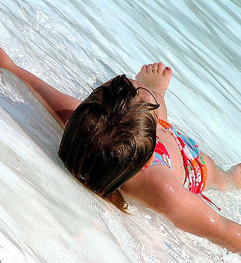
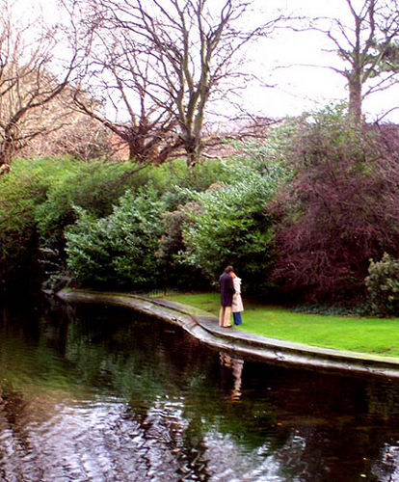
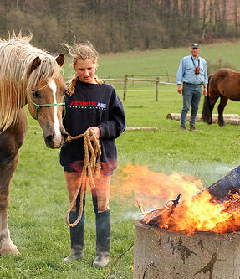
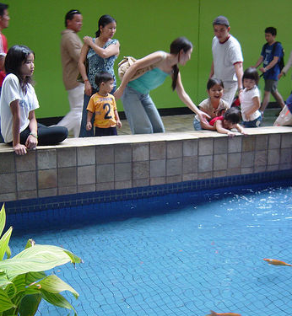
Images from Flickr

Slide 4
Flickr8K (Data)
8,092 Images
40,460 Sentences
Associated JPG
Test Images

Slide 5
Data Cleaning

Slide 6
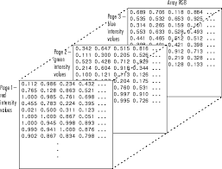
Image Conversion
Transform each Image Files from 3D to 1-D array
Used package VGG16
Map JPG file to feature array (time consuming)
Test Cleaning:
Lowercase
Remove punctuation
Remove stop words / numbers
Unique vocabulary ~ approx. 8,700

Slide 7
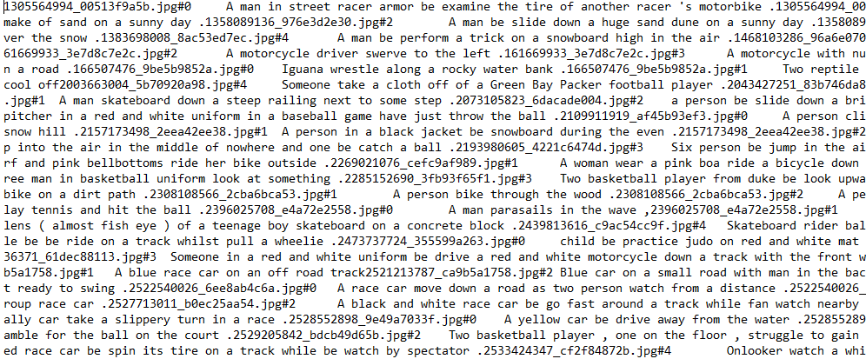
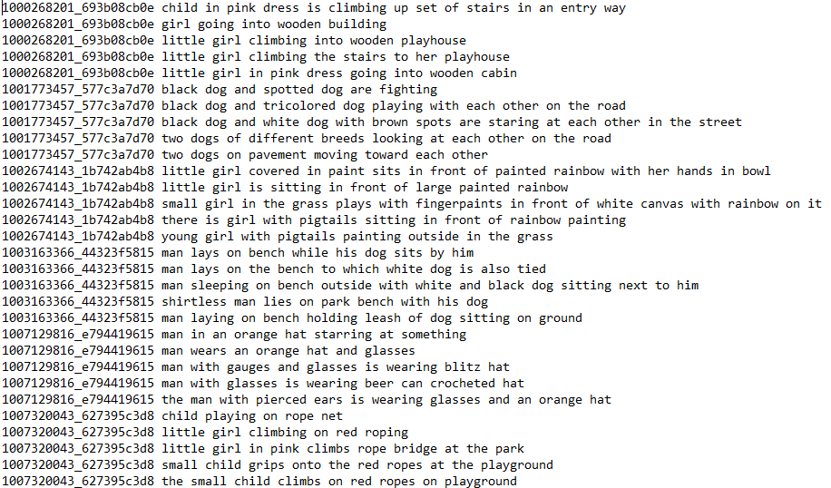

Original
Transformed

Slide 8
Neural Network Model

Slide 9
Model & Activation
Keras
Approximately two hours to run ONE epoch
Computationally taxing
Only ran one epoch
Activation Function ‘Relu”
Pre-Trained Model - VGG

Slide 10
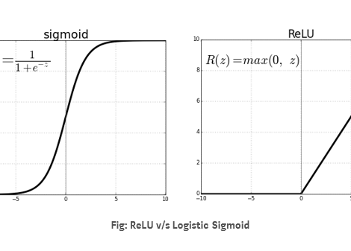

Activation Functions
ReLu Most used Activation Function in CNN
Good for image processing
Point to explore SoftPlus

Slide 11
NLP Tokenization

Slide 12
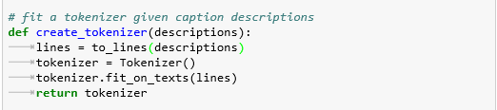
Text Processing
Keras - Tokenizer
Allows vectorization of text corpus
Each integer the index of a token in dictionary

Slide 13
Intuitive Idea (Basic)
Basic Idea: two input arrays: one photo (array) and one encoded text (array)
Output – recursively outputs out sequence of numbers
Embedding Layer: each sequence will then be mapped onto each of the words

Slide 14
BLEU Scores

Slide 15
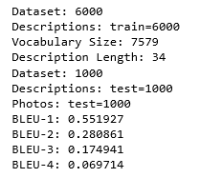
Results & Interpretation
Interpretation:
corpus_bleu()
0 – 1; closer to 1 is better (more correlated with human translation)
.55 is okay for unigram
Gets worse with each n-gram
Paper on BLEU:
https://arxiv.org/abs/1703.09137
See attached thresholds

Slide 16
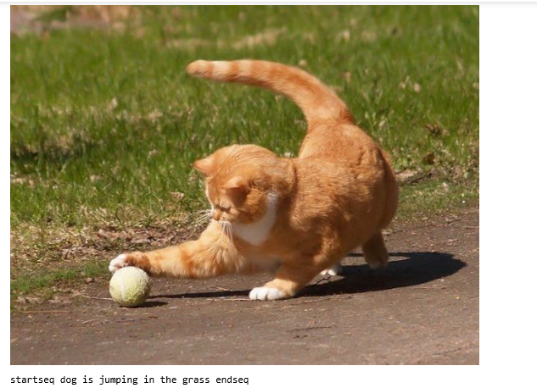

Slide 17
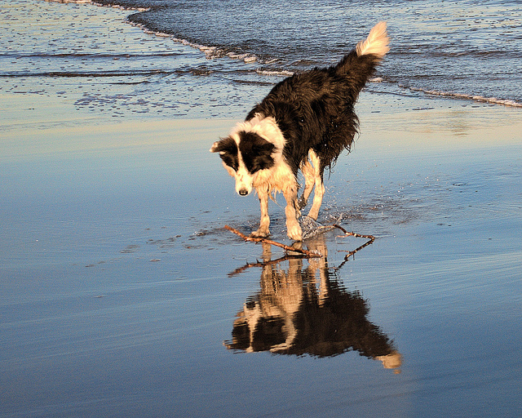
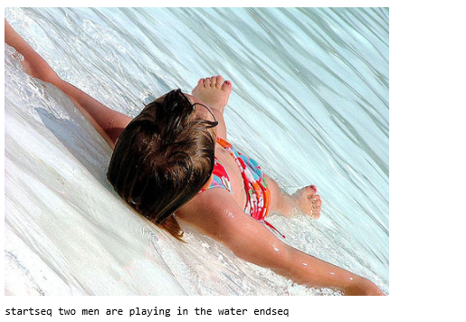

Slide 19
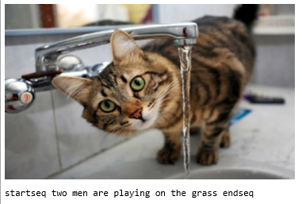

Slide 20
Improvements?
Test Self-Created Model to Backtest with SoftPlus
More epoch / iterations
More statistical testing (Only used BLEU-N as statistic)
Better Understanding of Model
Successes?
Novel field to explore
Some results (mixed)

Slide 21
Thank You!

